Slide 1
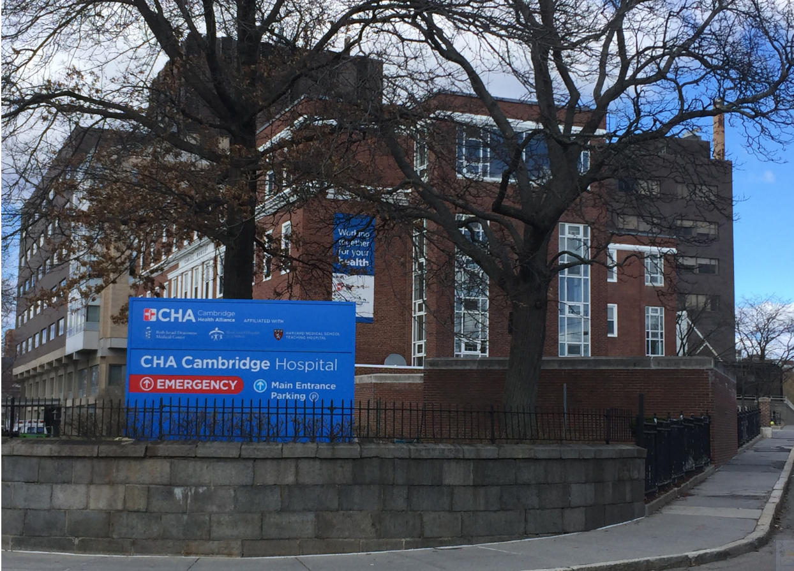
Breaking the Communication Barriers
A Staff Driven Initiative
Sarai Lamothe BSN, RN
Stephanie Racca BSN, RN
Candice Stahl BSN, RN
Notes:
Good Afternoon. My name is Stephanie Racca . I am a nurse manager at Cambridge Health Alliance. I am here today with two of my excellent staff nurses, Candice Stahl and Sarai Lamothe. We are very happy to have the opportunity to present to you today our work on facilitating improved communication on our unit, 4 West. This is a project with a long back story- one that is not unique to our unit or our facility. I’m sure many of you can relate to this work. I am going to present some of the background.
This is Cambridge Hospital- part of the Cambridge Health Alliance.
Cambridge Hospital is a Partnership between three community hospitals– Cambridge, Somerville, and Everett – each with 24-hour emergency services, 15 primary care practices and a total of
293 licensed beds.
As a public health facility It also provides a vital safety net for underserved populations facing barriers to care. These vulnerable populations are our special expertise.
The Alliance is also an Academic Community Health System for Harvard Medical School and the Tufts University School of Medicine
Cambridge Hospital has two 32 bed Med Surg Tele Units, a general ICU, maternity and inpatient psychiatry units.
Our unit is 4 West, a 32 bed Med Surg Tele Unit led by the nursing staff and 2 Medical Teaching teams
4W has had nursing leadership challenges with 5 Managers in 14 years and inconsistent processes which over time, evolves into conflicting messages to the staff.
In November 2014, CHA participated in a culture of safety survey. The biggest issue highlighted by the survey was communication based.

Slide 2
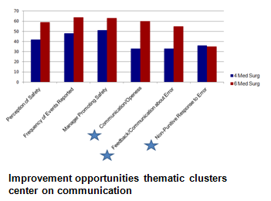
Notes:
This graph shows the outliers that triggered on the survey. These were assessed and grouped into thematic clusters. The common theme on 4 west was communication. This was common to our sister med surg unit as well so we initiated a project on safety huddles with the staff to promote an atmosphere of constructive reporting of issues without punitive action. This was actually presented last year in this forum and I am pleased to say that the safety huddles continue on both units and has migrated to other specialties such as maternity.
It was out of issues brought from the safety huddles how poor communication between nurses and nursing assistants was impacting our patient care.
(want to give some examples here)
As many of us know, the best solutions come from the people with the problems. But there needed to be a mediator to keep people on track and discourage negative and unproductive commentary. For this, I picked a representative from human resources.
Of course, this work had been done before on the unit so we wanted to be careful about replication.
Both RNs and CNAs felt they could not rely on each other for help.
Perceived lack of respect for each other and little understanding of each other's role in patient safety.
Lack of teamwork.
Concerns for patient safety.
Highlighted by Safety Huddles…Med Surg 4 found a unit opportunity to improve communication based on the responses from the 2016 Culture of Safety Survey

Slide 3
Focus Group Goals
Establish a safe environment for both nurses and nursing assistants to identify and openly discuss their concerns about communication problems.
Encourage mutual understanding on both sides with the help of the nurse manager and an HR staff.
Develop an appropriate communication style based on input from both the nurses and nursing assistants.
Share mutual agreements with all nurses and nursing assistants.
Periodic meetings to evaluate communication style improvement on the unit.

Slide 4
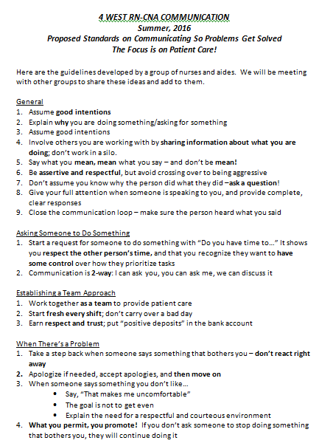
Feedback
Respect maintained during meetings.
Positive experiences shared on both sides.
Negative experiences discussed in a non-judgmental manner.
Overall ease with discussing negative experiences.
Willingness exhibited on both sides to work with each other beyond the focus group meetings.

Slide 5
What did we do to address the communication issues brought forward in the focus group?
Notes:
We’ve learned so far that there are clearly barriers to communication, voiced from both RNs and CNAs and we’ve also learned that both sides are supportive of the addressing these issues.
So….we made a movie!
Our motivation for creating the movie arose from conversations in the focus group.
From our conversations it became very clear that both RNs and CNAs agreed that overall communication and teamwork on the floor needed to be improved, but there were very different perspectives on where the breakdown in communication was occurring and who could make changes.
Further, there were several specific examples of poor communication or lack of understanding that were repeatedly brought up in our groups. We realized that perhaps the best way to really address these common communication complaints was to depict scenes that illustrated the “Incorrect or Bad” version of a specific scenario vs. the “Correct or Good” version of how communication ought to be carried out. 6 scenarios in total were depicted in the film--3 that were put forth by the CNAs and 3 by the nurses.

Slide 6
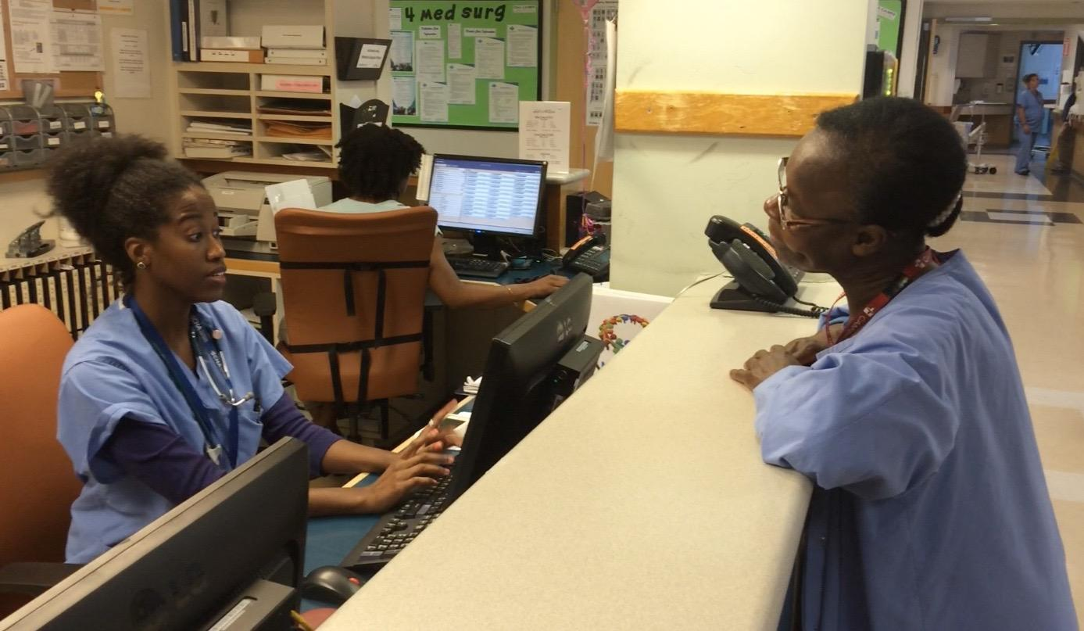
Implicit Messaging
CNA: Can you help me with something?
RN: Ask one of your colleagues to help.
CNA: Aren’t you my colleague?
Notes:
One scenario brought forward by the CNAs had to do with the issue of implicit messaging around respect.
We have here a CNA on the right asking the nurse for assistance. RN responds, “Ask one of your colleagues”. CNA responds, “Aren’t you my colleague?”
This was a real example that the CNAs of our focus group brought to the meeting. It was an important indicator to them that the RN did not feel that the two parties are equal and led to feelings of disrespect and anger. Further, this type of implicit message shuts down communication between the two groups, which impairs patient safety.

Slide 7
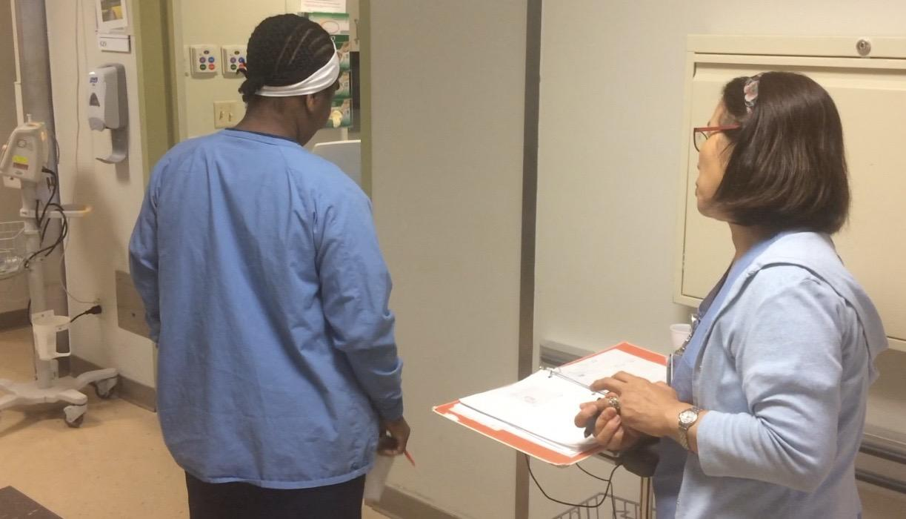
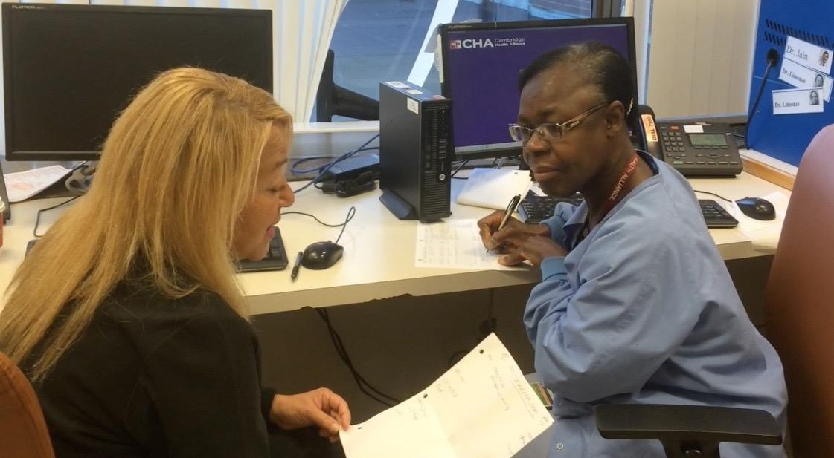
A Breakdown in Communication
RN to CNA Patient Report
Notes:
When asked to identify areas where improved communication is needed, many nurses on our floor identified the RN to CNA report as an area that needed improvement. We depicted a “good vs. bad” example of RN to CNA report in our communication video. Above you see the CNA facing away from the nurse as she gives report, no eye contact, not taking notes and walking away from the nurse before report is finished. Below, you see the CNA facing the nurse, giving verbal responses (mmm-hmm) and writing notes.
This area of communication breakdown is particularly important because RN to CNA report is a crucial time to communicate safety concerns. This is when staff can learn from each other about fall risks, specific vital signs to monitor, special precautions and diets, etc.
Poor communication leaves patients vulnerable to inconsistent care and possibly risk of harm.

Slide 8
Responses to the Communication & Safety Movie
"If I ask someone for something, I do it differently, I try to be nicer. I'm better about passing on tasks so that I know that things aren't left undone." CNA
"Overall there’s been improvement…it improved most right after the video, but things were back to normal after a couple of weeks." RN
"People don't say ‘go get your colleague’ anymore." CNA
"There is more of a mutual understanding of shared experiences and what could be improved." RN
"One nurse said to me recently, 'When you're ready to clean that patient, call me and I'll help you.' That was a big change. But there is still room for growth...I think it's going to get better." CNA
Notes:
What were surprising results?
—One surprising result was the notable appreciation and change in attitude that occurred among many of the staff from the onset simply because this issue was being addressed. Before we had developed a list of approaches or movie, staff were notably happy that this important issue was being addressed.
Unsurprising Results
—

Slide 9
Applying these lessons to other facilities
Include an objective outsider to facilitate mediation.
Include fair representation of staff.
Continue to address the issue. Nothing is solved or finished after a few meetings. The efforts to improve communication must be on-going.
"We still have problems with communication on this floor. A little bit has changed. Some people changed a little bit, but not everyone. I want to know what is next." CNA

Slide 10
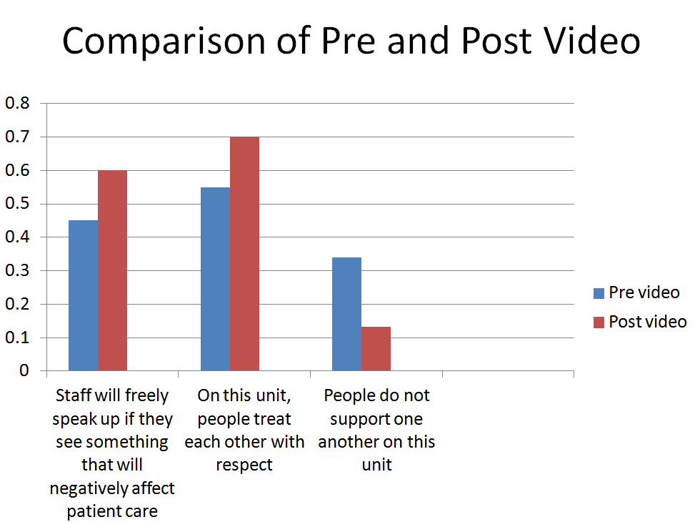
Notes:
To take a temperature of

Slide 11
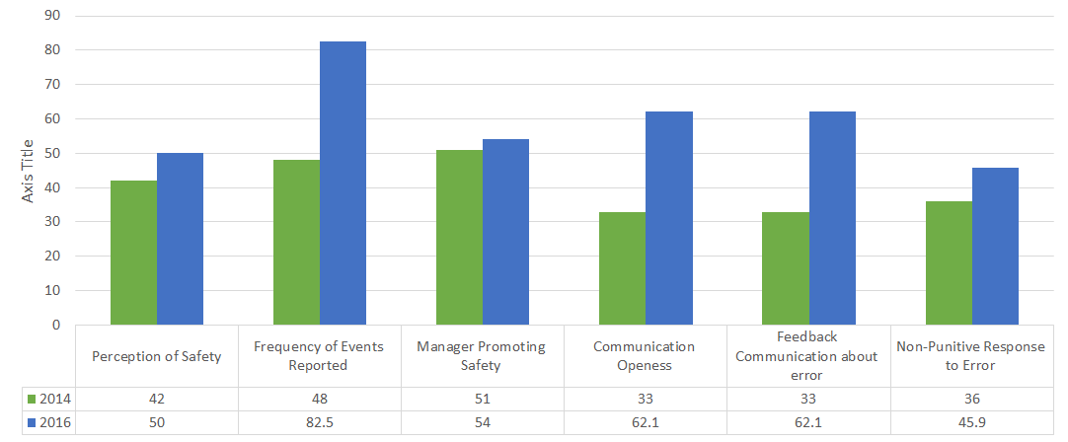
Culture of Safety Comparison
Notes:
Improvement over all indicators from 2014 through 2016
We changed our vendor to the Advisory Board for the Survey in 2016

Slide 12
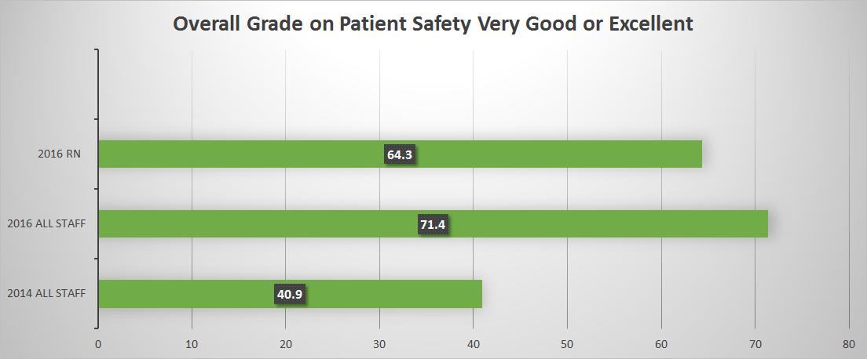
Overall Grade on Patient Safety Excellent or Very Good
Notes:
Culture of safety survey 2016 results.

Slide 13
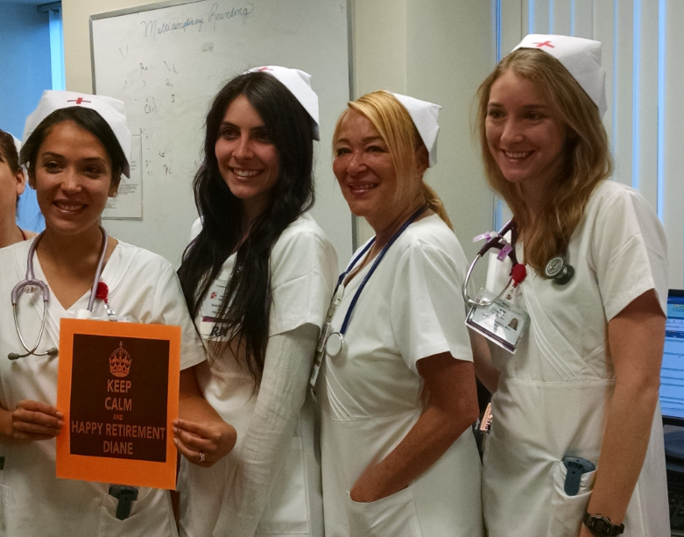
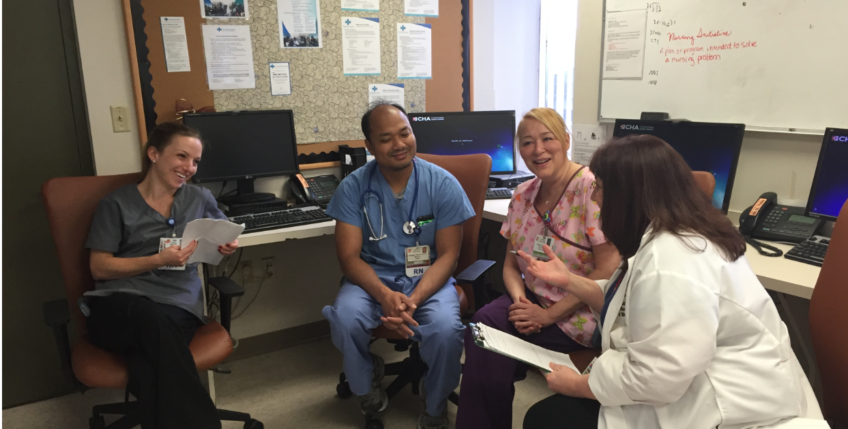
Thank you!
Please contact Stephanie Racca with any questions or feedback
sracca@challiance.org

